Slide 1
“Ranges In Progress”
System & Process Overview
Notes:
Merchandising Ranges in Progress System
Course
Notes
Version 2.0

Slide 2
New Ranging Systems Overview
Ranging
Controls
CW /RMS
(product
Info)
Ranging
System
(Assort)
ProSpace
ProSpace
VMCS
Ranges in
Progress
VMCS
(Store
Specific)
Supply Chain
Stores

Slide 3
Key Benefits
View and Select Range Data sent from CRST
Send Range Data to ProSpace
Extract Placeholders from CRST
Reconcile Ranges and Merchandise Plans
Authorise Ranges
Maintain Settings

Slide 4
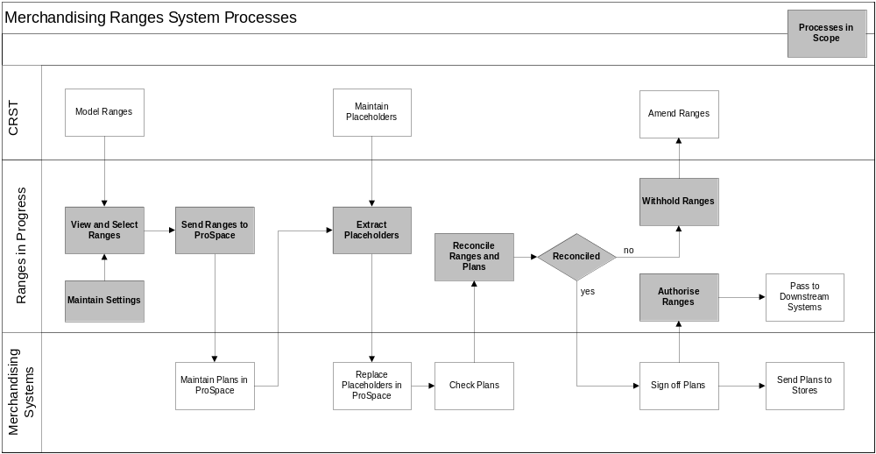
RIP System Process

Slide 5
Basic System Overview
LOGIN
MERCH GROUP
SUMMARY
(HOME)
RANGE
STATUS
STORE RANGE
GROUP INFO
RECONCILE
AUTHORISE
LEVEL OF
CHANGE

Slide 6
Navigation and Login
Basic Navigation
Login
Merchandising Group Summary Screen
LOGIN
MERCH GROUP
SUMMARY
(HOME)
RANGE
STATUS
STORE RANGE
GROUP INFO
RECONCILE
AUTHORISE
LEVEL OF
CHANGE

Slide 7
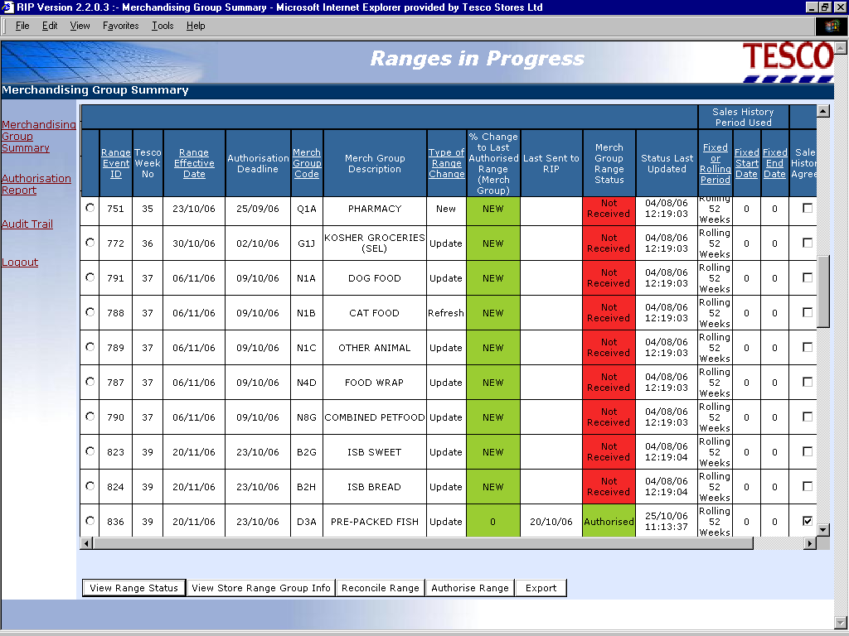

Slide 8
Range Status
Basic Navigation
View Range Status
View Range Status Details
LOGIN
MERCH GROUP
SUMMARY
(HOME)
STATUS
STORE RANGE
GROUP INFO
RECONCILE
AUTHORISE
LEVEL OF
CHANGE

Slide 9
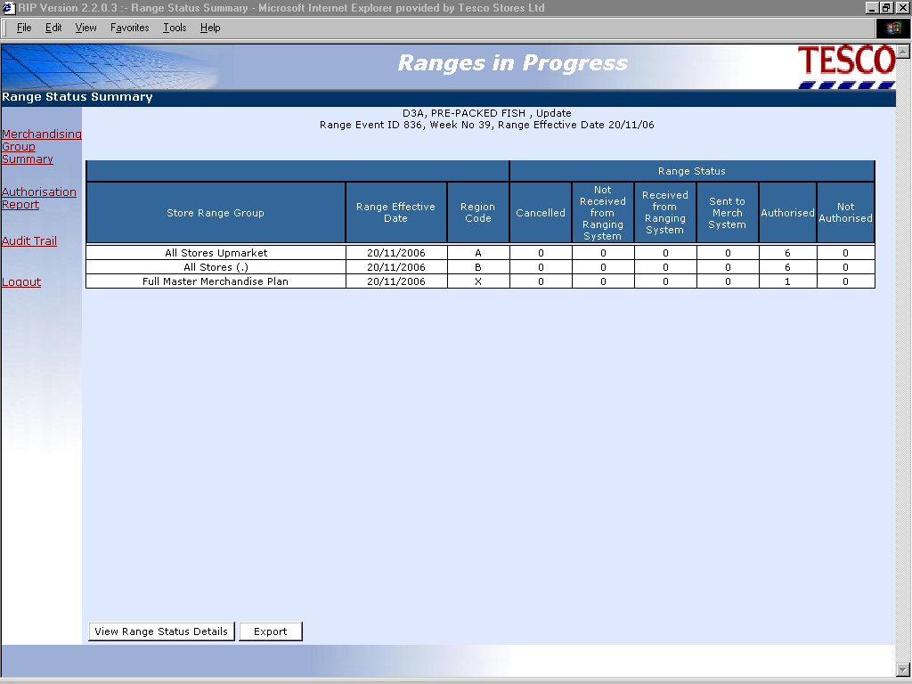

Slide 10
Store Range Group Info
Areas to cover
  Store Range Group Summary
  Level of Change
  Product Summary
  Product Detail
  Product Matrix
  Product Sales
LOGIN
MERCH GROUP
SUMMARY
(HOME)
STATUS
STORE RANGE
GROUP INFO
RECONCILE
AUTHORISE
LEVEL OF
CHANGE

Slide 11
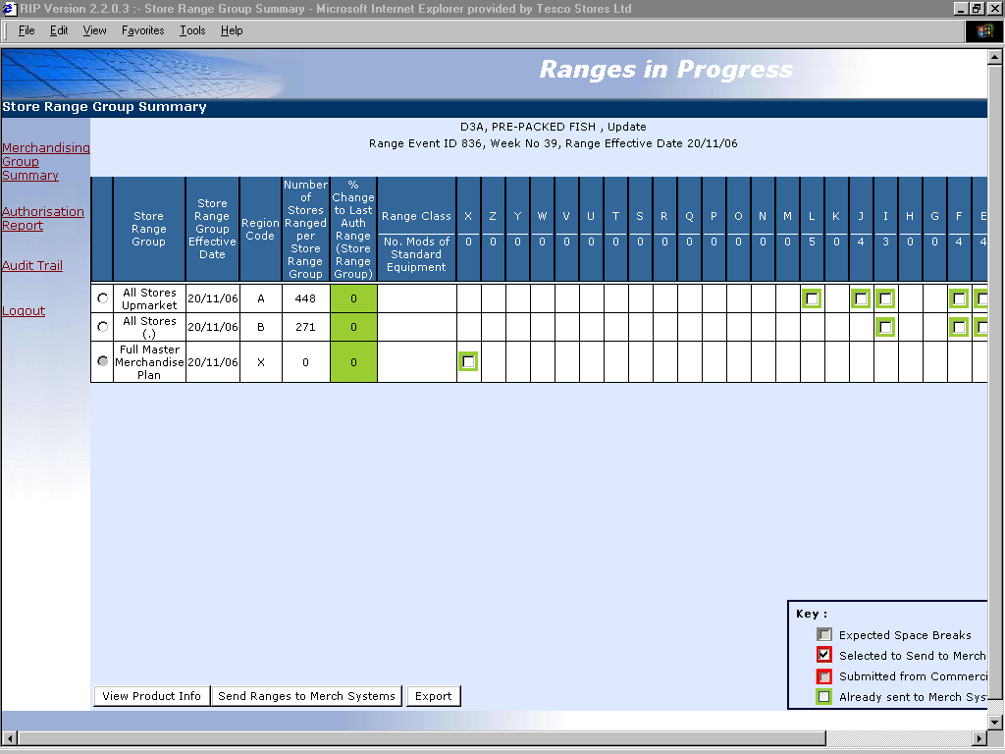

Slide 12
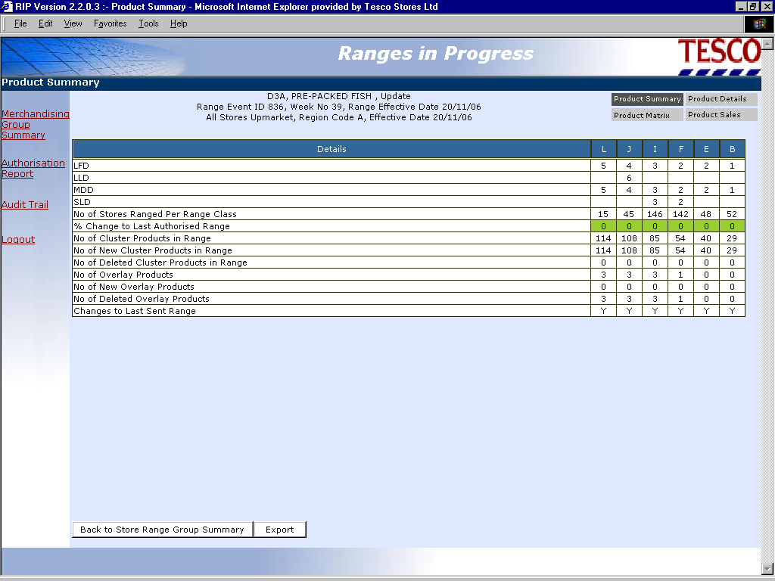

Slide 13
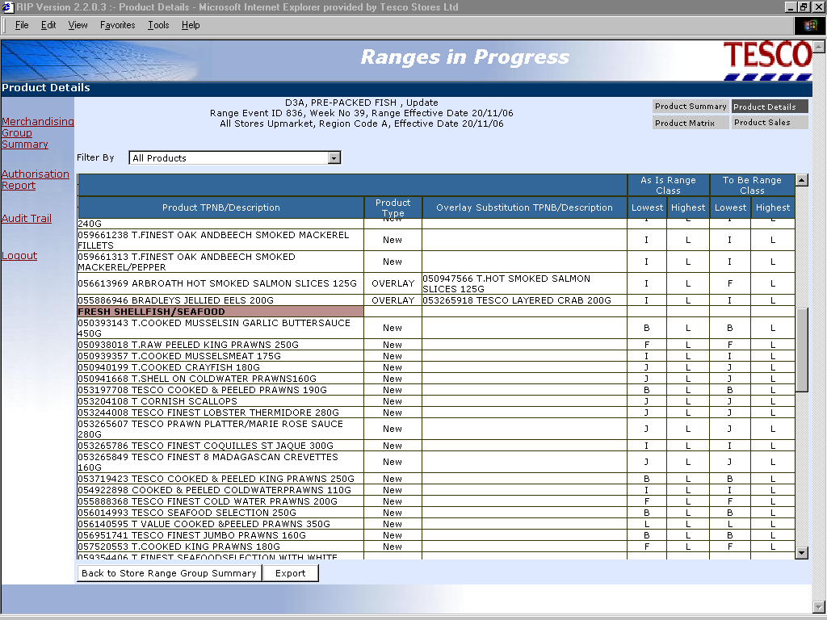

Slide 14
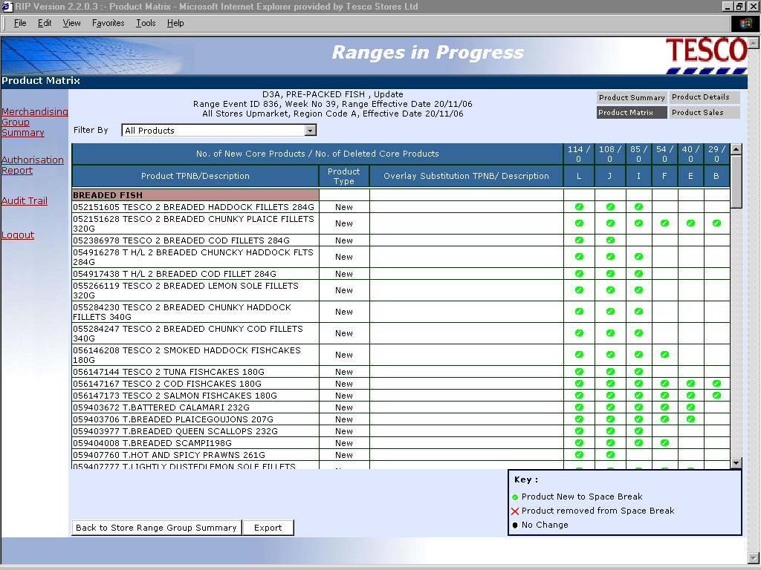

Slide 15
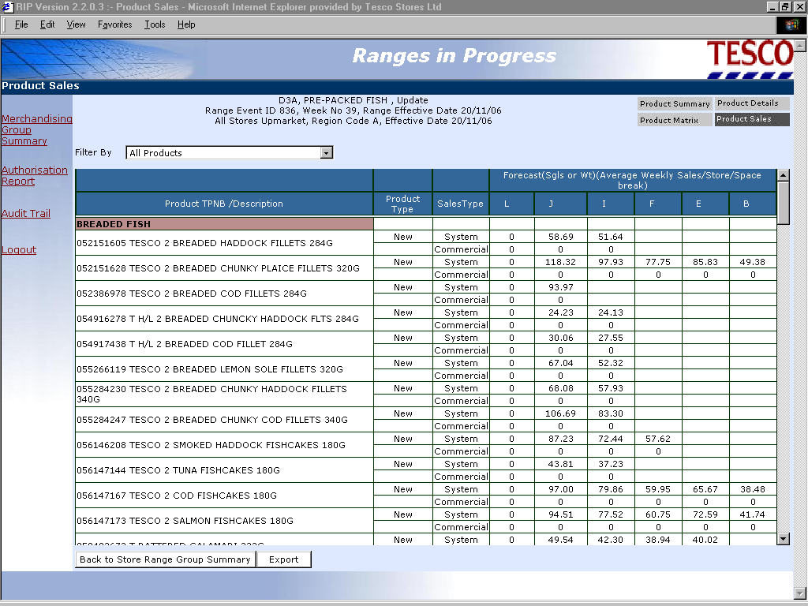

Slide 16
Product Sales
Sales used to build Merchandise Plans (in Work in Progress) are consistent with sales used to plan ranges in the Ranging system.
These can either be:
  “Rolling” i.e. 52 weeks average, the default for most Merchandising Groups
  “Fixed” i.e. defined sales history period, selected for highly seasonal areas
  “Forecast” i.e. system generated or input by Commercial for individual products, including new lines
Each time new range information is sent from Ranges in Progress to ProSpace the updated sales data is passed with it.
Actual sales are used to calculate Level Run Down on Plans (in Live) and are updated on a weekly basis.

Slide 17
Reconcile
Reconciliation Areas to cover
  Store Range Group
  Errors Summary
  Errors by Merchandising Group
  Errors by Level of Change
  Errors by Merchandising Plan
  Errors by Product
LOGIN
MERCH GROUP
SUMMARY
(HOME)
STATUS
STORE RANGE
GROUP INFO
RECONCILE
AUTHORISE
LEVEL OF
CHANGE

Slide 18
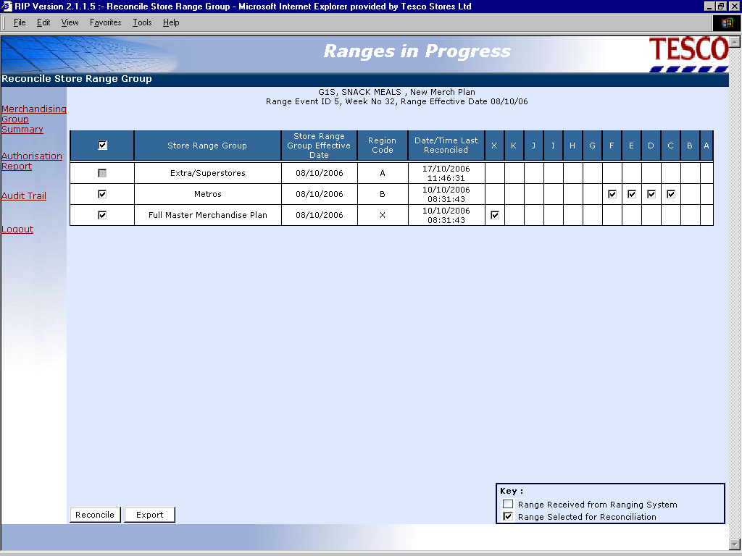

Slide 19
Reconciliation Errors
Products are in the range but not on the plan
Products are on the plan but not in the range
Dummy New Product present in ranges and plans
Products not currently authorised in CW
Products in a plan that don’t meet level run down in ProSpace
Products do not fit on a merchandise plan
Unacceptable levels of change within space breaks
Ranges expected but not received from the Ranging System
Inappropriate sales history used
No plans exist in ProSpace

Slide 20
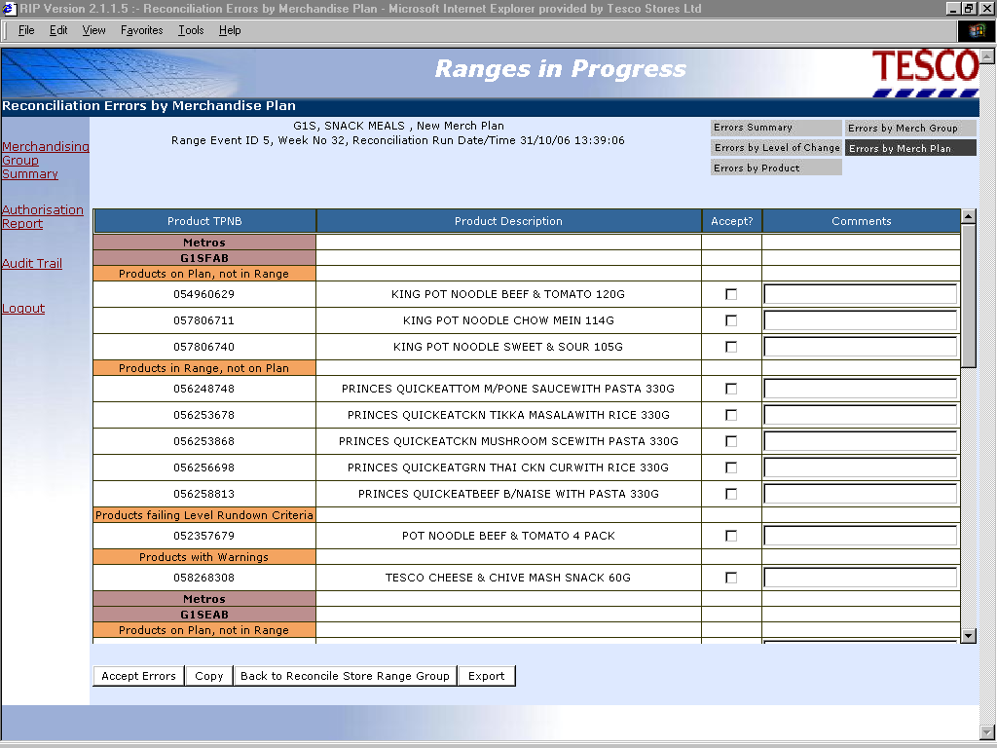

Slide 21
Authorise
Areas to cover
  Authorise Store Range Groups
  Final Reconciliation
  Authorise Ranges
LOGIN
MERCH GROUP
SUMMARY
(HOME)
STATUS
STORE RANGE
GROUP INFO
RECONCILE
AUTHORISE
LEVEL OF
CHANGE

Slide 22
Reconciliation Errors that can be Accepted
A reconciliation error screen will only be displayed if errors of the relevant type exist for the selected clusters during final reconciliation.
Only if all the errors for a cluster have been corrected or accepted will it be possible to authorise the cluster.
Notes:
Ranges in Progress - The System

Slide 23
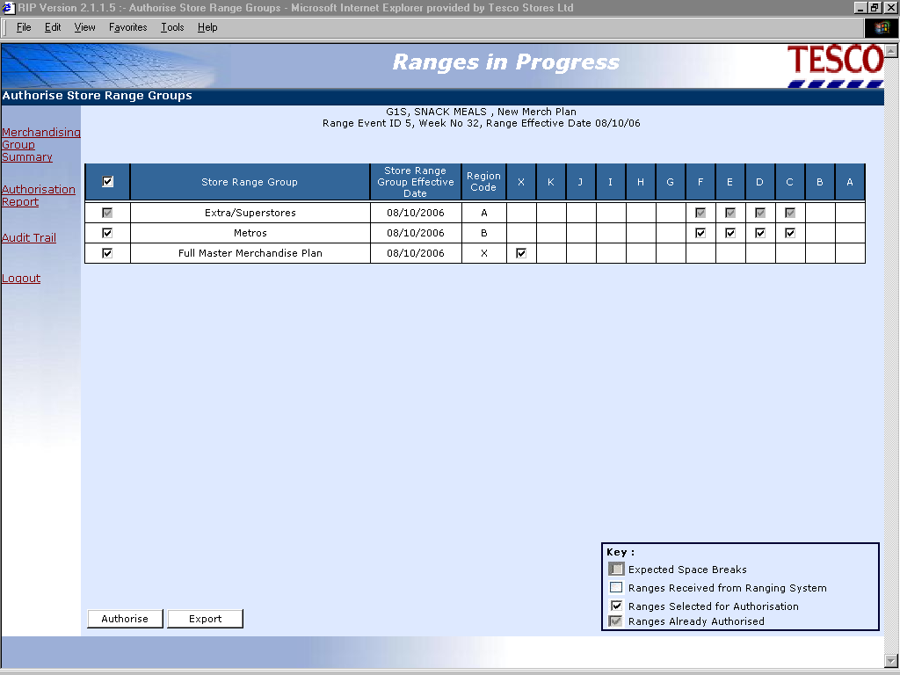

Slide 24
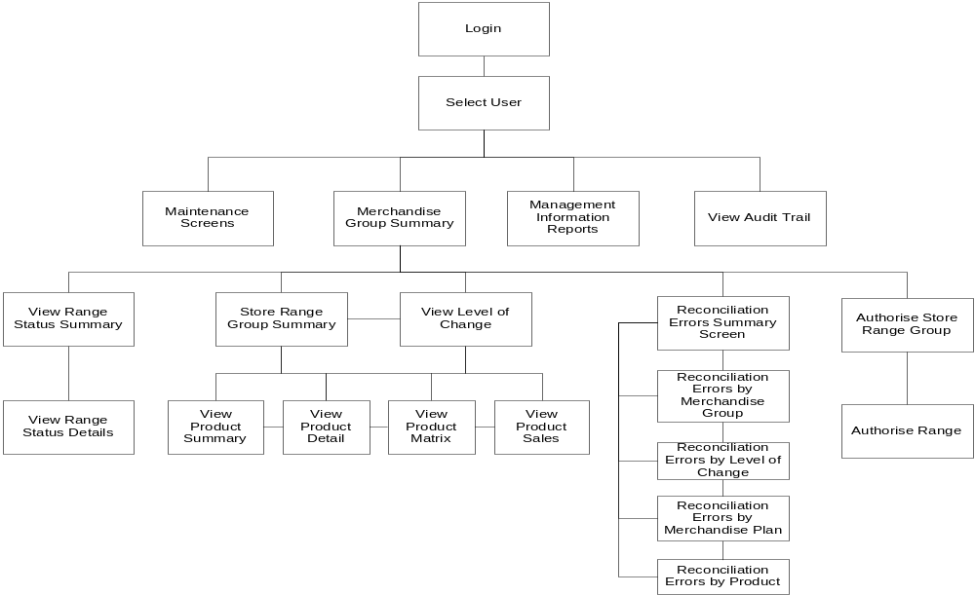
  Ranges in Progress Screen Navigation

Slide 25
  Merchandising Group Summary Screen
Merchandising Group Summary Sort Order:
Range Change ID | Tesco Week Number | Range Effective Date |  | Authorisation Deadline | Merch Group Code |  | Merch Group Desc | Type of Range Change | % Change to Last Auth Range (Merch Group) |  | Last Sent to RIP | Merch Group Range Status |  | Status Last Updated | Sales History Period used |  | Sales History Agreed | Forecast Override
001 | 09 | 01/05/2005 |  | Dd/mm/yyyy | B1B |  | Bread | Update | 10% |  | Dd/mm/yyyy Hh:mm | Auth |  | Dd/mm/yyyy Hh:mm | Dd/mm/yyyy |  | ✓ | Y/N
002 | 11 | 15/05/2005 |  | Dd/mm/yyyy | S1G |  | Cereal | New Merch Plan | 28% |  | Dd/mm/yyyy Hh:mm | In Prog |  | Dd/mm/yyyy Hh:mm | Dd/mm/yyyy |  | ✓ | Y/N
003 | 16 | 19/06/2005 |  | Dd/mm/yyyy | G3A |  | Canned Fruit | New Merch Plan | 25% |  | Dd/mm/yyyy Hh:mm | In Prog |  | Dd/mm/yyyy Hh:mm | Dd/mm/yyyy |  |  | Y/N
004 | 16 | 19/06/2005 |  | Dd/mm/yyyy | D2A |  | Milk | Refresh | 20% |  | Dd/mm/yyyy Hh:mm | Not Received from Ranging |  | Dd/mm/yyyy Hh:mm | Dd/mm/yyyy |  |  | Y/N
View Range Status |  |  | View Store Range Group Information |  |  | Reconcile Range |  |  |  | Authorise Range |  |  | View/Print Authorisation Report |  |  | Print Screen

Slide 26
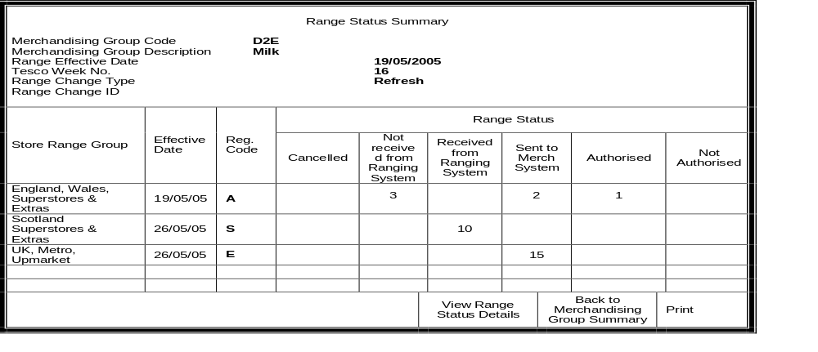
  Range Status Summary Screen

Slide 27
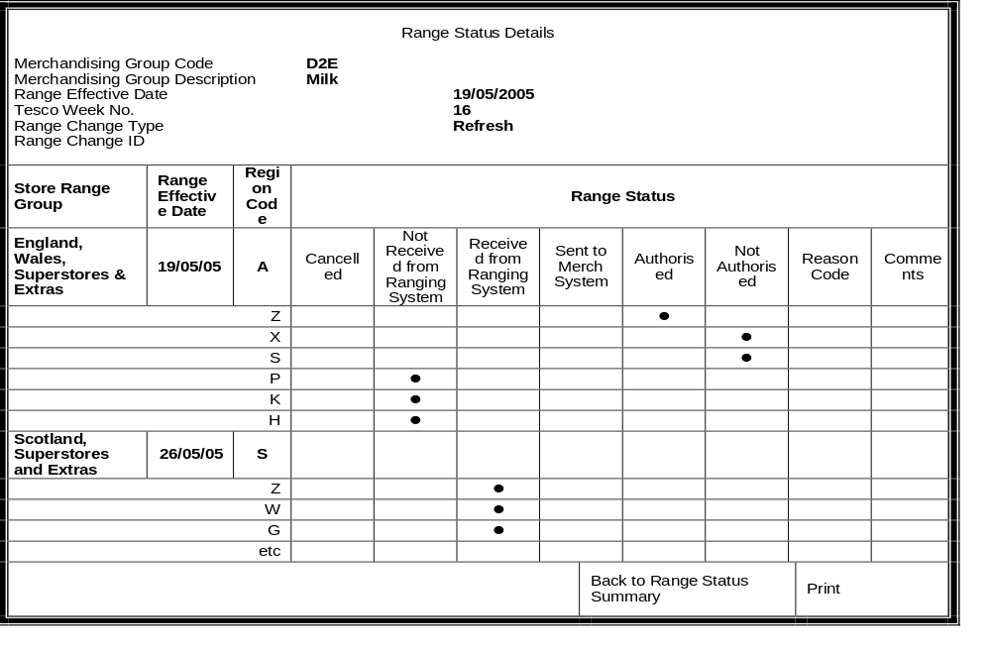
      Range Status Details Screen

Slide 28
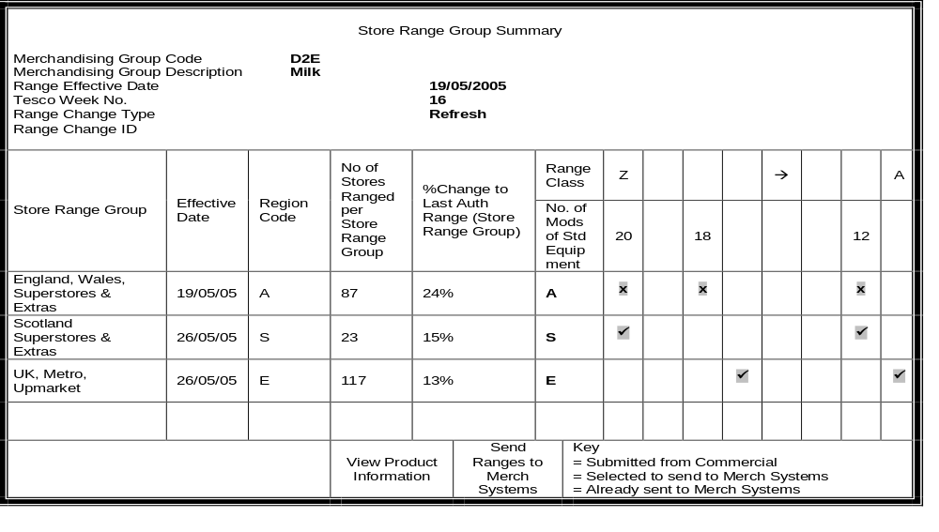
  Store Range Group Summary Screen

Slide 29
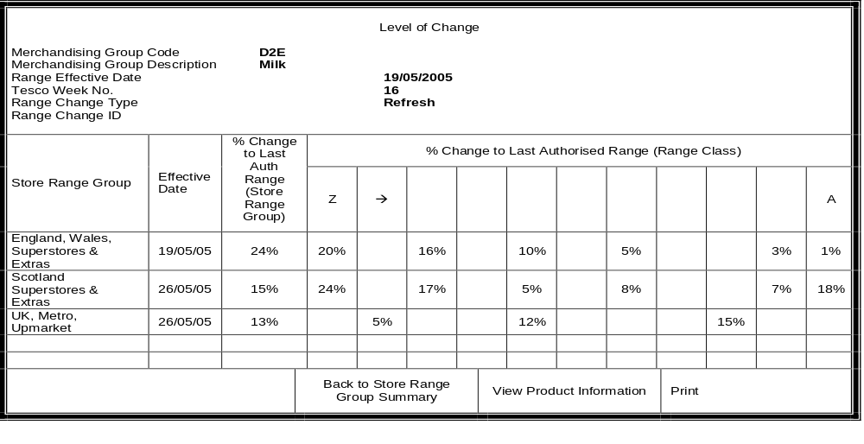
  Level of Change

Slide 30
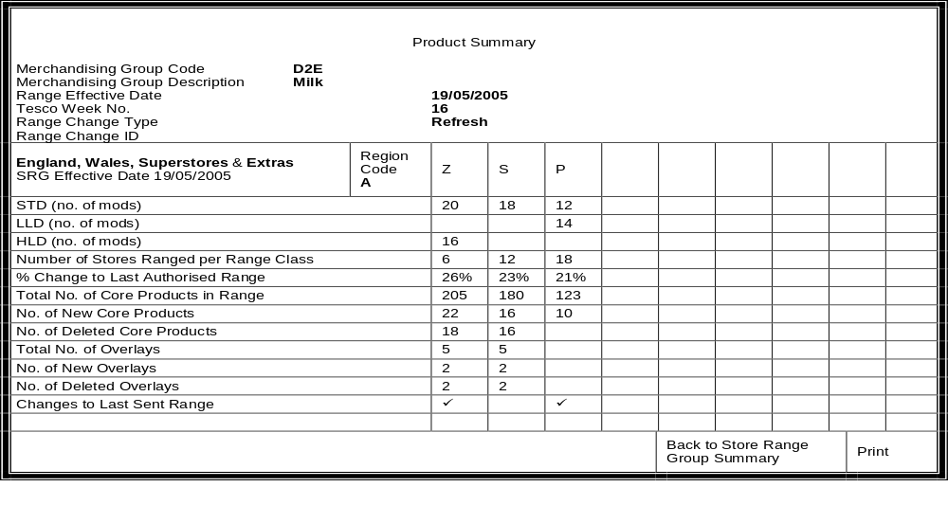
  Product Summary Screen (Tab 1)

Slide 31
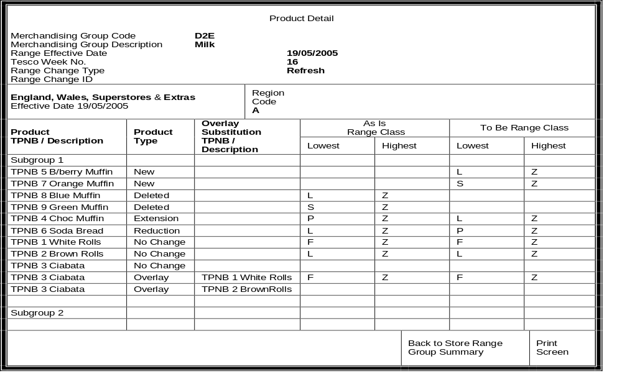
  Product Detail Screen (Tab 2)

Slide 32
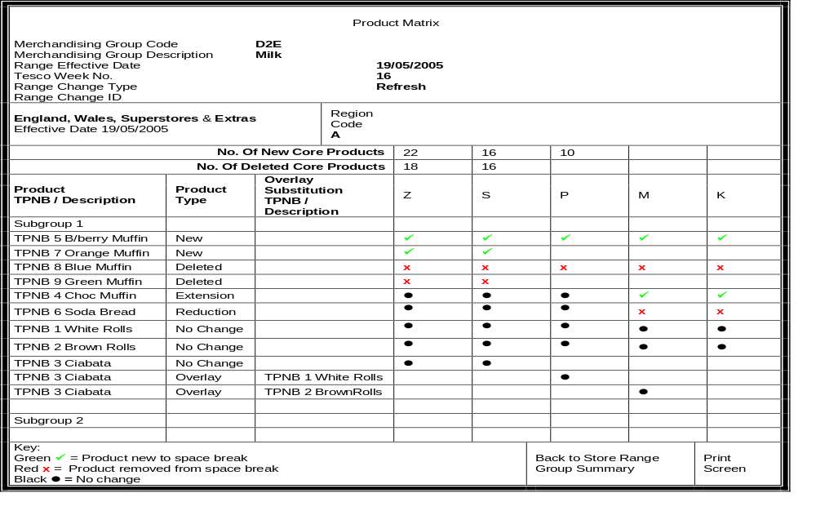
  Product Matrix Screen (Tab 3)

Slide 33
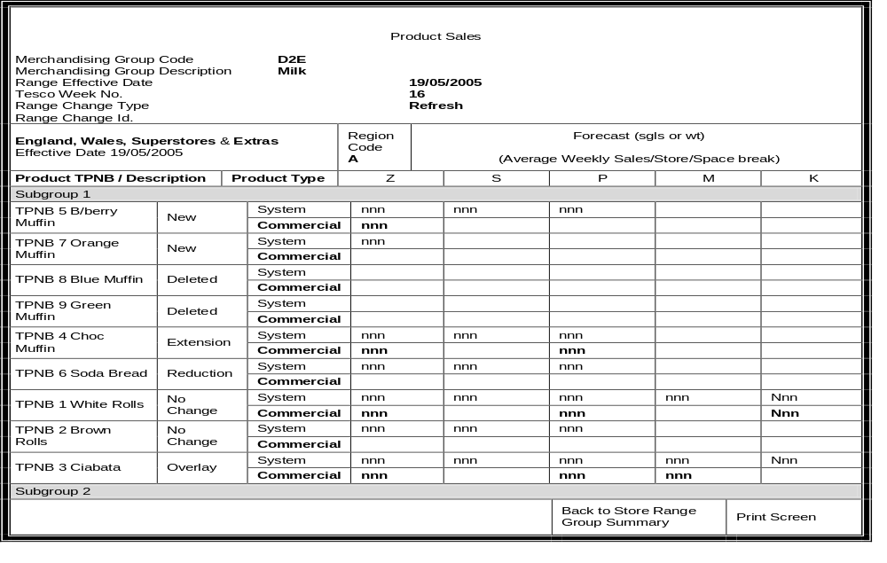
      Product Sales Screen (Tab 4)

Slide 34
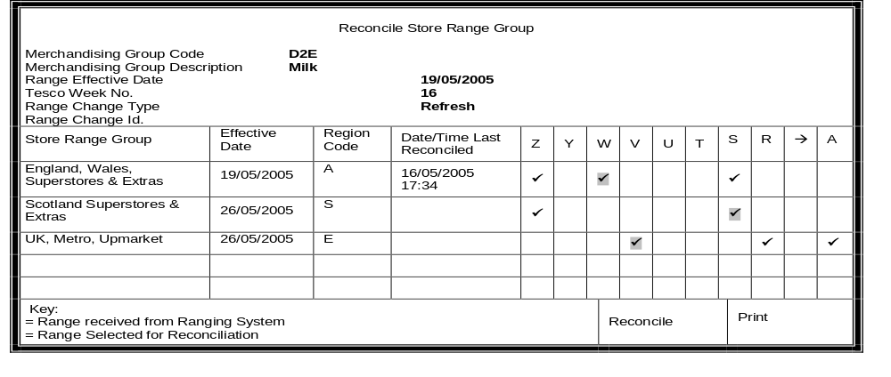
  Reconcile Store Range Group Screen

Slide 35
Reconciliation Errors
Products are in the range but not on the plan
Products are on the plan but not in the range
Dummy New Product present in ranges and plans
Products not currently authorised in CW
Products in a plan that don’t meet level run down in ProSpace
Products do not fit on a merchandise plan
Unacceptable levels of change within space breaks
Ranges expected but not received from the Ranging System
Inappropriate sales history used
No plans exist in ProSpace

Slide 36
  Reconciliation Errors Summary Screen (Tab 1)
View Reconciliation Errors Summary Reconciliation Run: Date/Time Merchandising Group Code D2E Merchandising Group Description Milk Range Effective Date 19/05/2005 Tesco Week No. 16 Range Change Type Refresh Range Change Id.
Store Range Group | Effective Date | Region Code | Number of Product Mismatches per Range
 |  |  | Z | Y | W |  | V | U | T | S |  | R | → | A
England, Wales, Superstores & Extras | 19/05/2005 | A | 0 |  | 0 |  |  |  |  | 0
Scotland Superstores & Extras | 26/05/2005 | S | 5 |  |  |  |  |  |  | 15
UK, Metro, Upmarket | 26/05/2005 | E |  |  |  |  | 10 |  |  |  |  | 20 |  | 0
 |  |  |  |  |  | Back to Reconcile Store Range Group |  |  |  |  | Print

Slide 37
      Reconciliation Errors by Merchandising Group (Tab 2)
Reconciliation Errors by Merchandise Group Reconciliation Run: Date/Time Merchandising Group Code D2E Merchandising Group Description Milk Range Effective Date 19/05/2005 Tesco Week No. 16 Range Change Type Refresh Range Change Id.
Placeholders on Plan
TPNB/ Description
TPNB /Description
TPNB/ Description
Unauthorised Products in Range
TPNB/ Description
TPNB/ Description
TPNB/ Description
Sales History Agreed Y
 | Back to Reconcile Store Range Group | Print

Slide 38
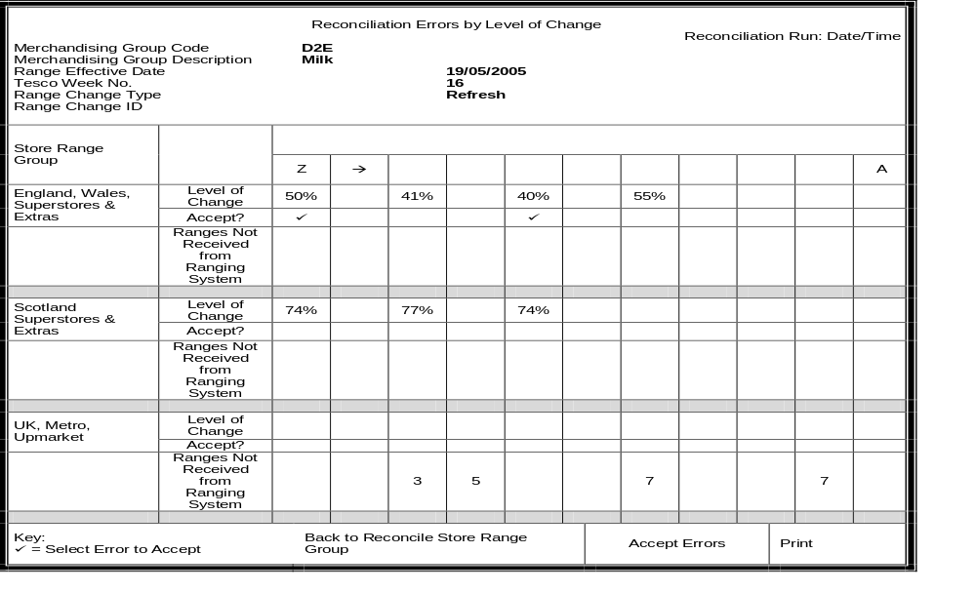
  Reconciliation Errors by Level of Change (Tab 3)

Slide 39
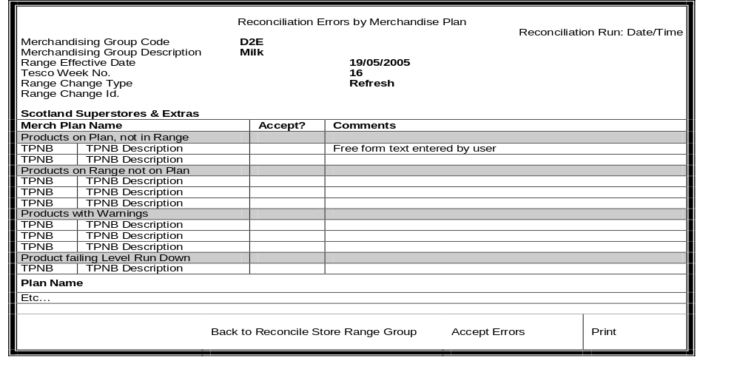
  Reconciliation Errors by Merchandise Plan (Tab 4)

Slide 40
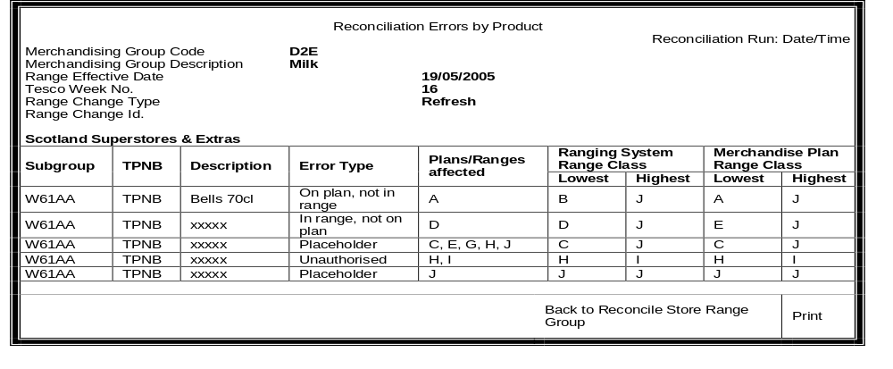
  Reconciliation Errors by Product (Tab 5)

Slide 41
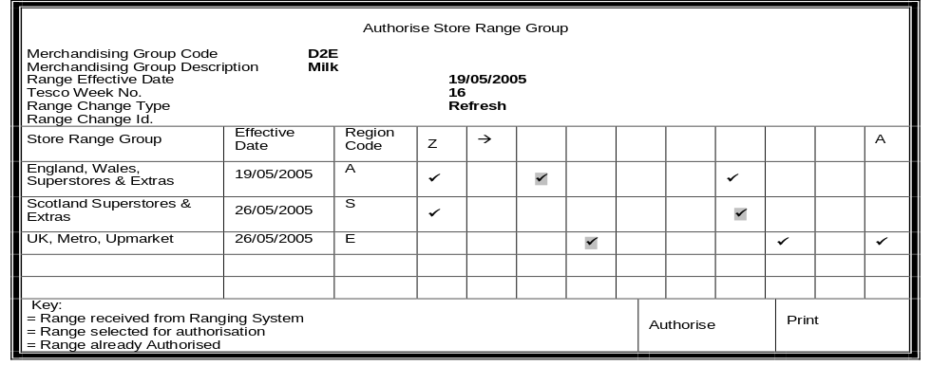
      Authorise Store Range Group Screen

Slide 42
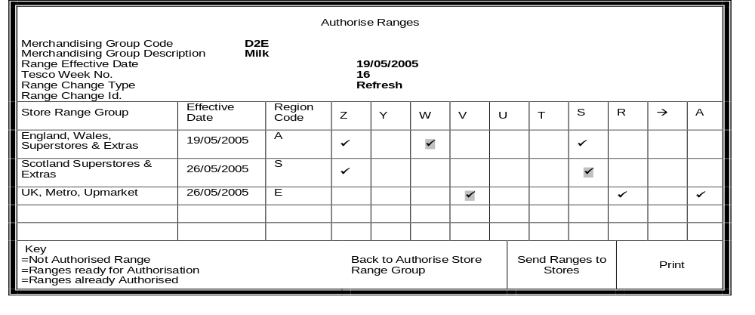
  Authorise Ranges Screen

Slide 43
  Thank You !!

